Slide 1
R01 Specific Aim 1
2.29.2024

Slide 2
Data summary
Quality control summary
Initial images:
Normative CT images: 1495
Craniosynostosis
CT images: 534
3D photos (pre-surgical only): 410
Note: Only one image from each patient with craniosynostosis was selected (either CT or 3D photo)
Total images after quality control: 1786
CT images: 1391
3D photograms: 395
Image quality control protocol
CT images were discarded due to inadequate field of view, artifacts, or poor image quality
3D photos were discarded due to poor image quality or artifacts
Landmarks were manually checked, existing landmarks placed by photographer were used when available
Image summary
Normative: 1155
634 male, 521 female
Sagittal suture fusion: 394
285 male, 109 female
Metopic suture fusion: 125
91 male, 34 female
Coronal suture fusion: 58
Right: 39 (16 male, 23 female)
Left: 19 (4 male, 15 female)
Multiple suture fusion (including Bicoronal): 54
26 male, 28 female
Total craniosynostosis: 631

Slide 3
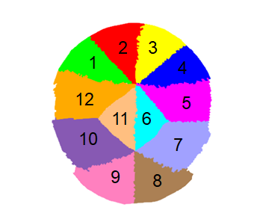
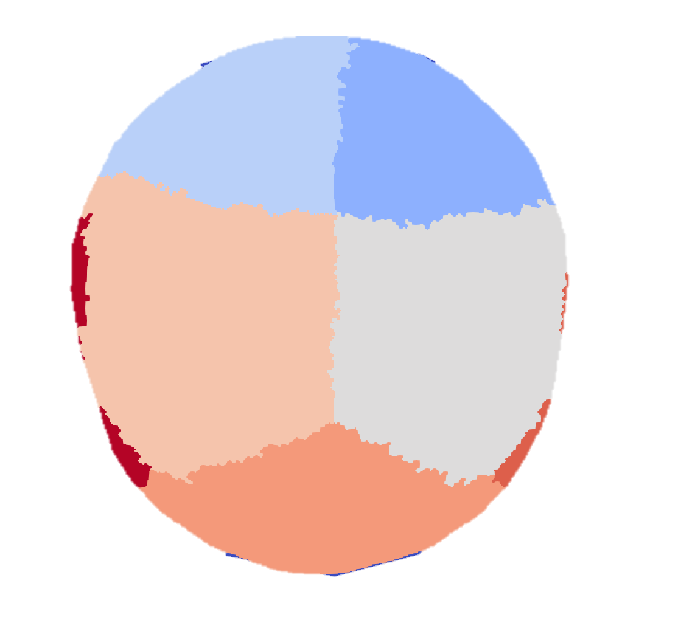
Region based map
Bones are labeled according to our template
Labeled bones are split into twelve regions
identified based on the closest suture
Regions containing the temporal bones (blue arrows) are not considered in analysis

Slide 4
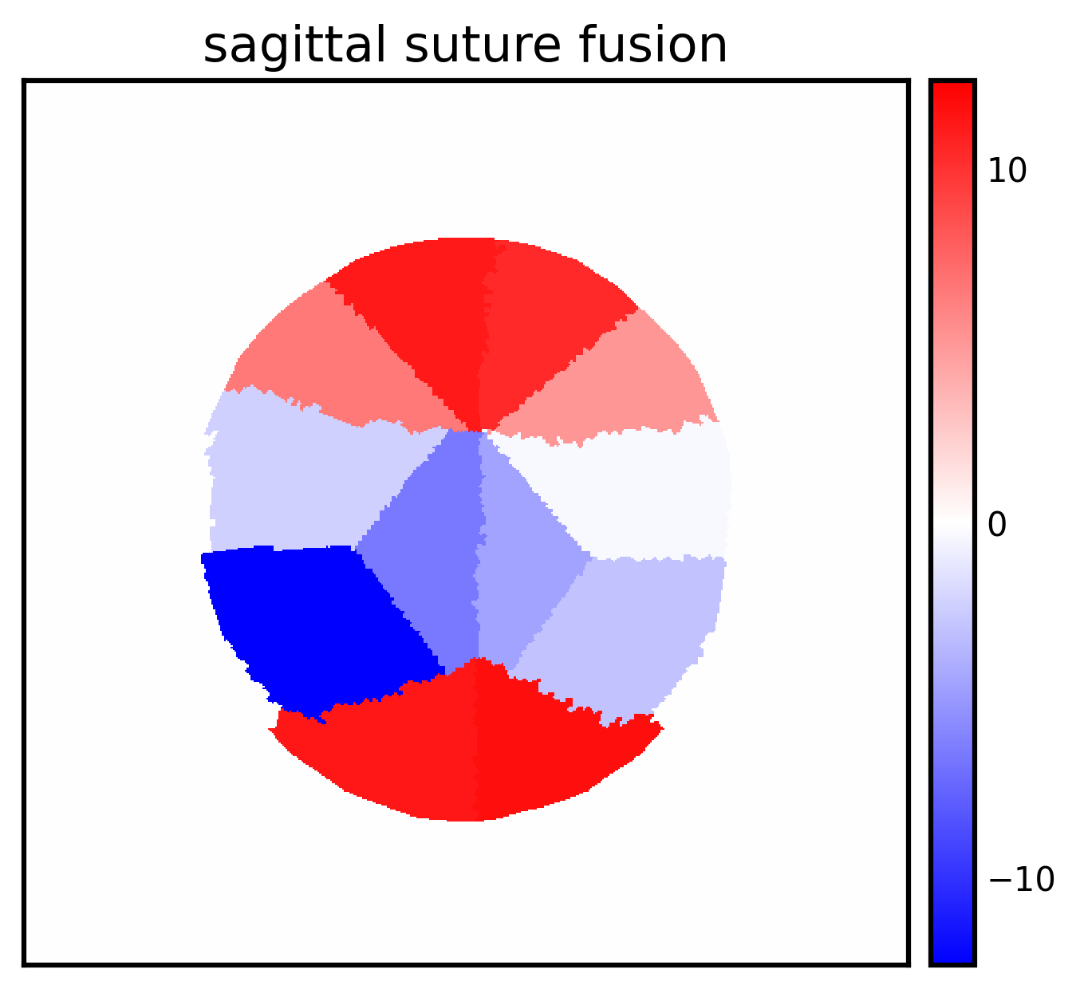
Sagittal suture fusion
What patterns would we expect:
Regions 1-4 and 8,9 have increased volume
Regions 5-7, 10-12 have decreased volume
N=394
Observations:
Patients head shapes are highly symmetric
Characterized by volume loss in parietal bones on both sides
Significant volume overgrowth is observed in the front of the cranium
Lower, but present volume overgrowth is found in the rear of the cranium
Mean volume difference (mL)

Slide 5
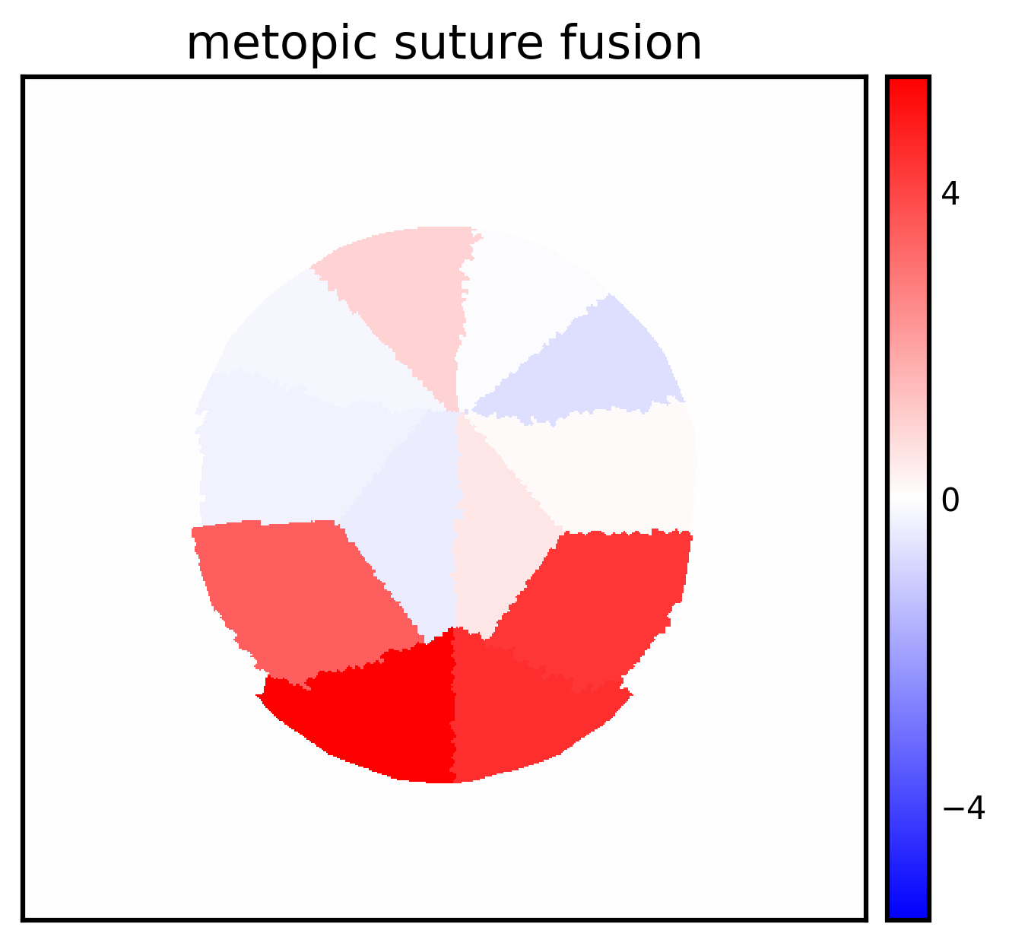
Metopic suture fusion
What patterns do we expect:
Lack of volume in the frontal bones, particularly regions 1 and 4
Increased growth in the back of the cranium, compensates for lack of frontal growth
N=125
Observations
Increased growth in occipital, parietal regions
Moderate malformations
Less “severe” head shapes as compared to other phenotypes
Mean volume difference (mL)

Slide 6
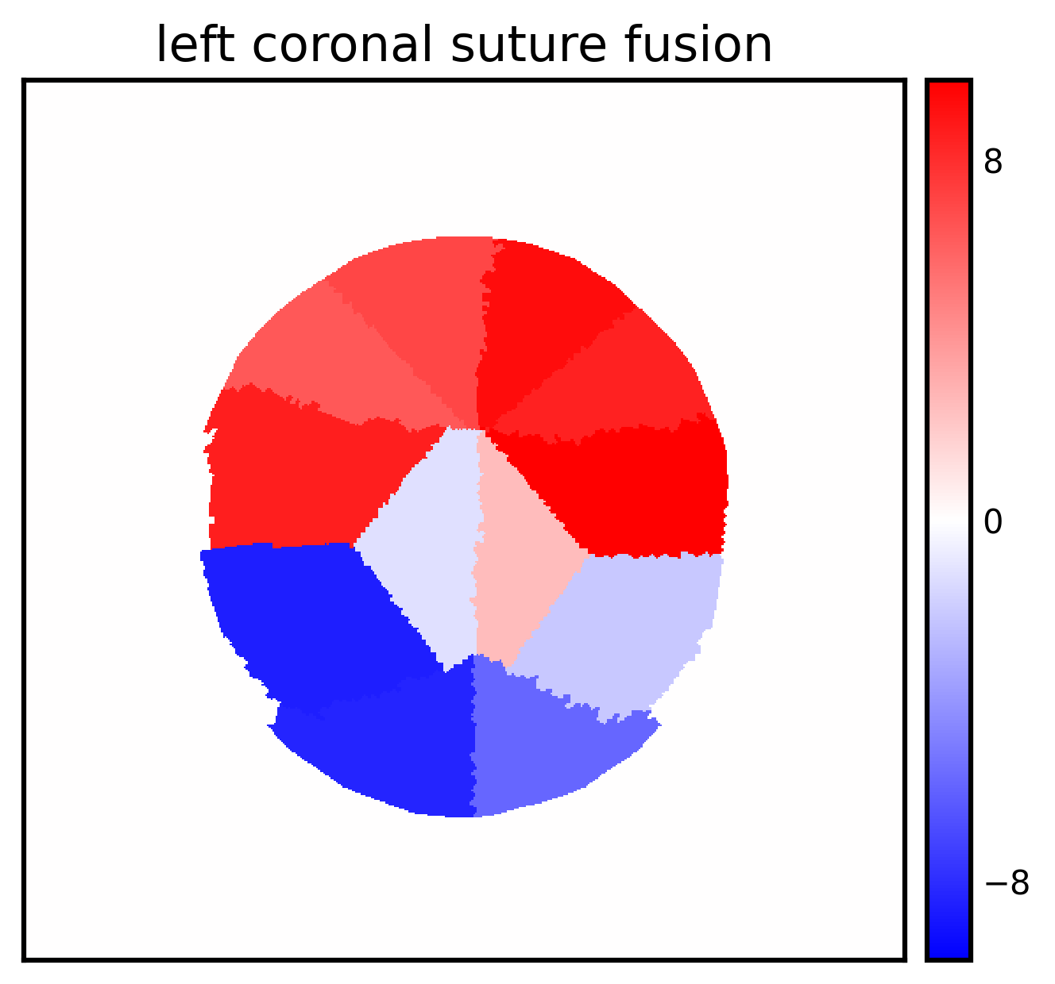
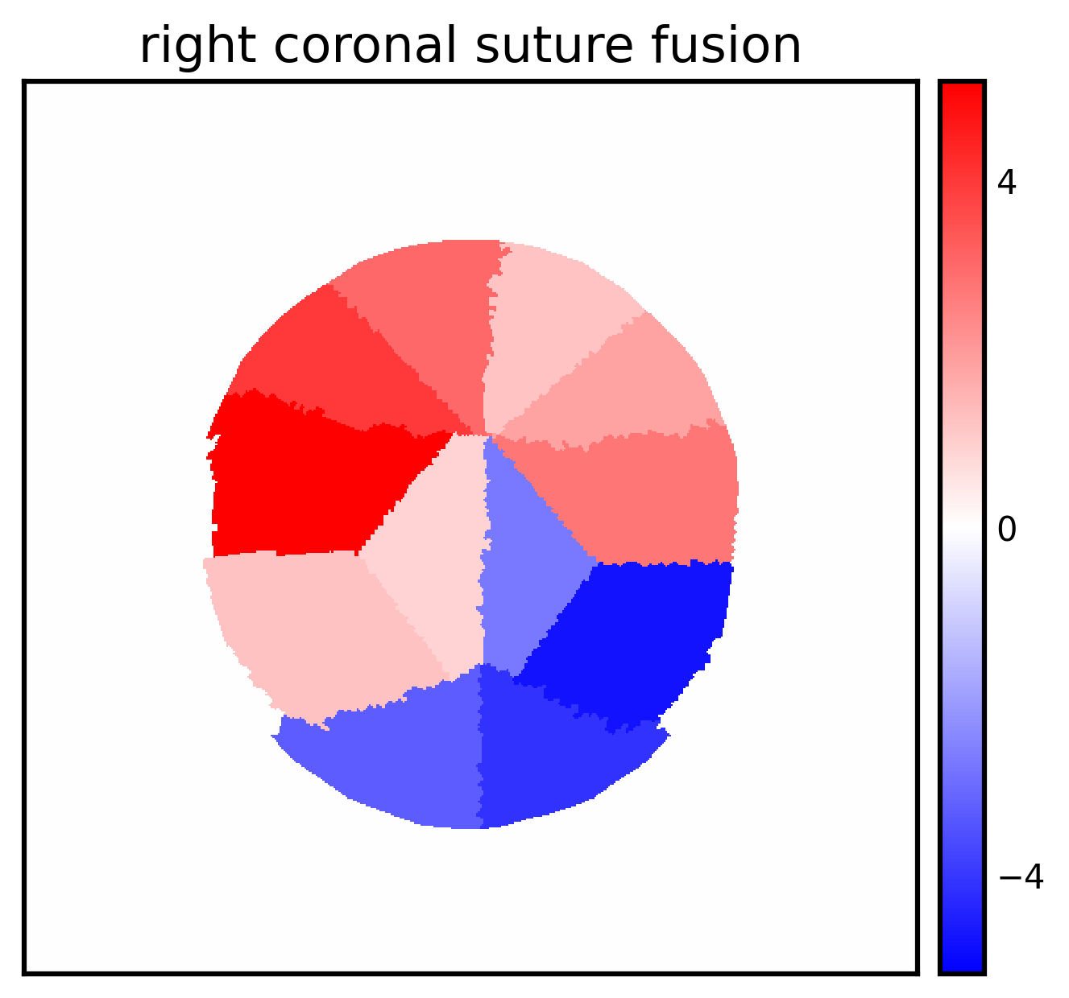
Unicoronal suture fusion
What patterns do we expect:
Left unicoronal:
Lack of volume on left side (regions 1, 2, 12)
Increased volume on contralateral side
Right unicoronal
Lack of volume on right side (regions 3,4, 5)
Increased volume on contralateral side
N=58 (39 right, 19 left)
Significant volume loss on same side as suture fusion
Moderate volume loss at suture fusion area
Volume gain on front contralateral side from suture fusion
Mean volume difference (mL)

Slide 7
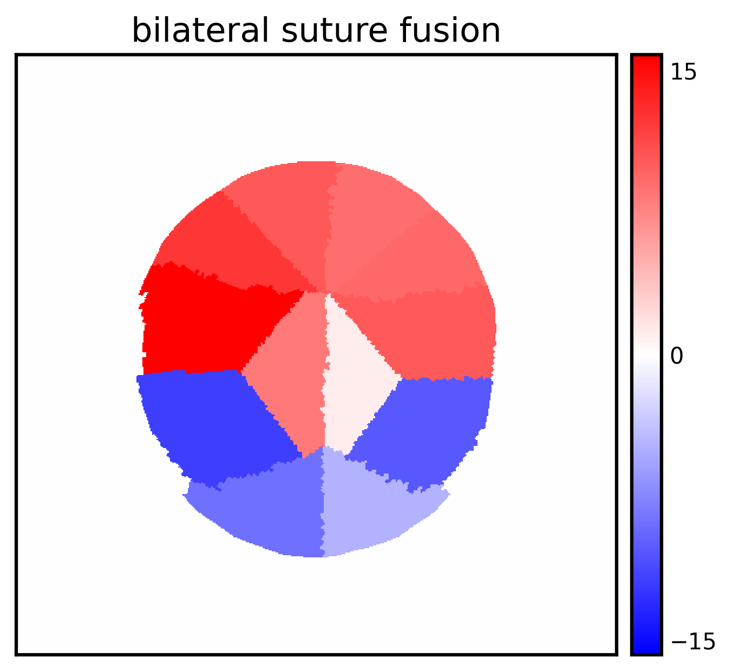
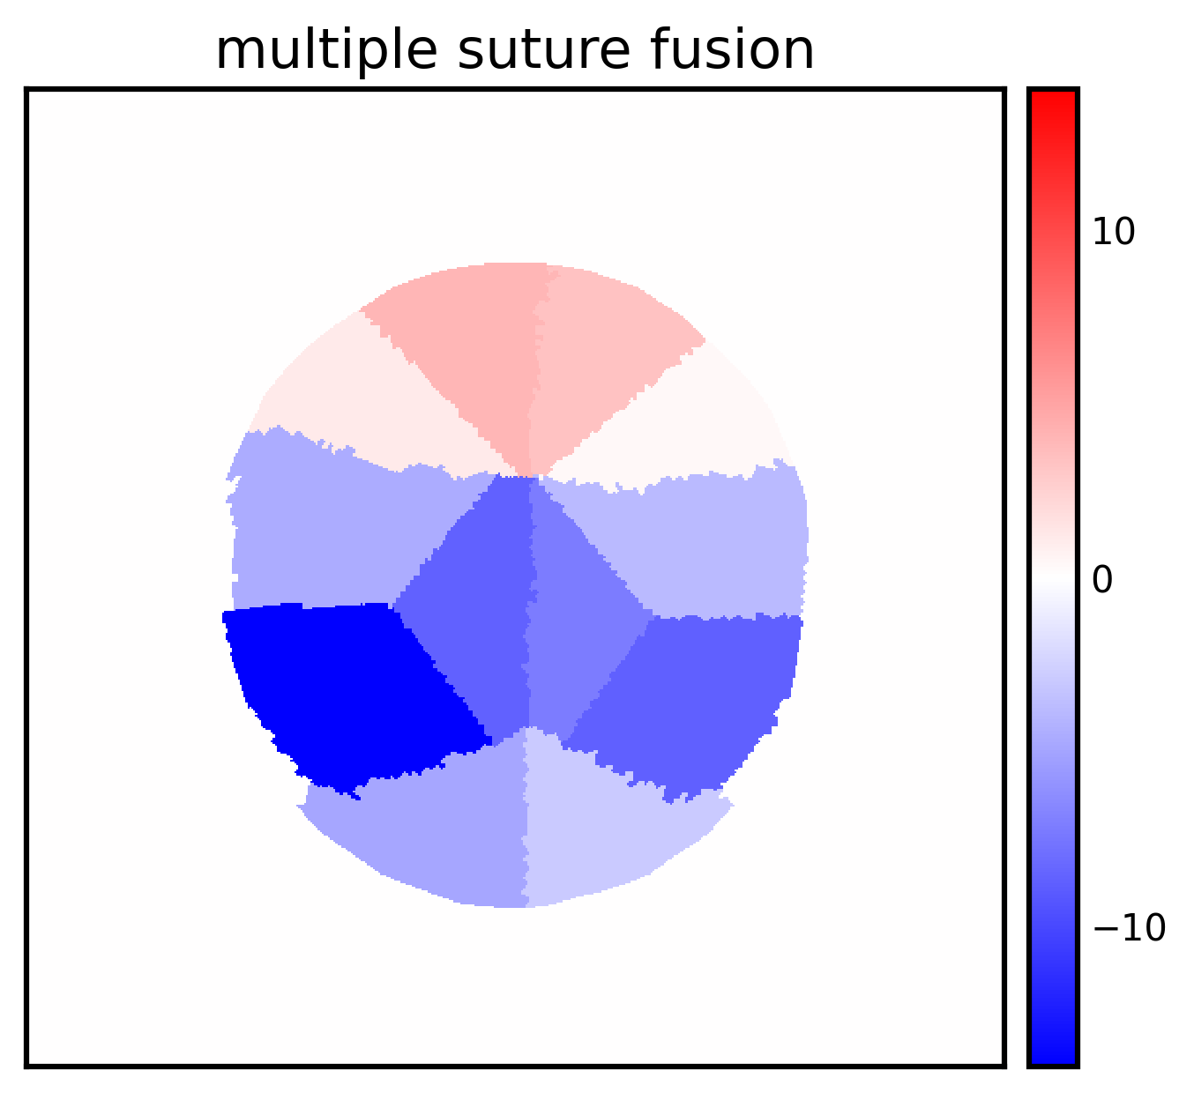
Multiple suture fusion
N = 54
N=38 bicoronal
N=16 multiple suture fusion (non-bicoronal)
Bicoronal phenotypes are similar to observed phenotype for unicoronal patients
Increased volume in anterior, decreased in posterior
Some patients with severe phenotypes are present in this group
Specifically severe when sagittal + other sutures are involved
1 case of pan-synostosis (X36)
Dramatically decreased cranial size
Mean volume difference (mL)

Slide 8
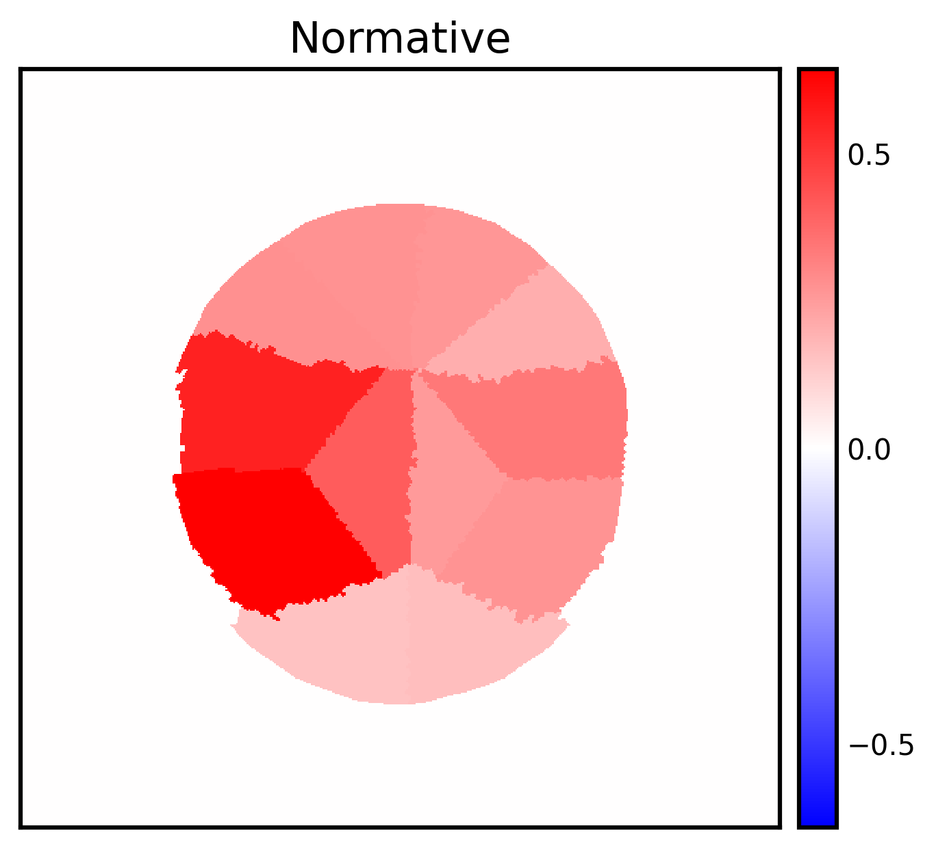
Normative (no suture fusion)
We patterns do we expect:
No distinguishing patterns that are significant across the population
N=1155
Modeling results presents underestimation of mean shape
Constrained head shapes are “smaller” than actual head shapes
There are many subjects in this dataset that display “abnormal” head shapes, e.g. flattening in back of cranium (loss of volume in regions 7-8)
Mean volume difference (mL)

Slide 9
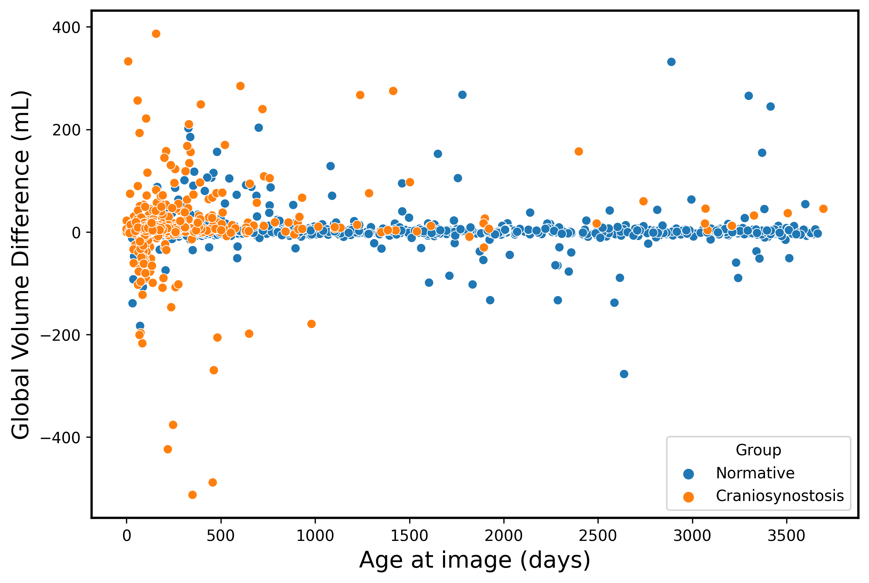
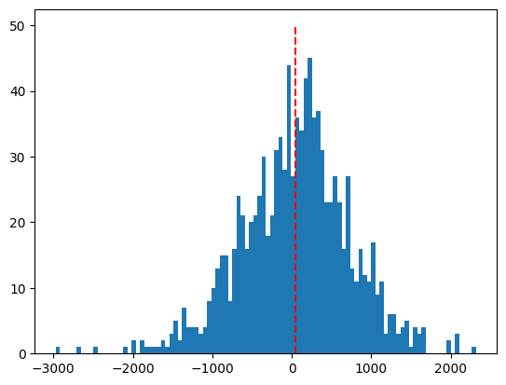

Global volume results
PC 1 fitting error per patient
(PC 1 component value – estimated mean)
$$Mean error = 44.10$$
Mean PC 1 value estimated using Arcsinh regression function at patient’s age and sex
Errors should be evenly distributed about 0
Systematically overestimating mean value in PC1 (similar results in all PCs)
Constrained head shapes are on average smaller than true head shapes

Slide 10
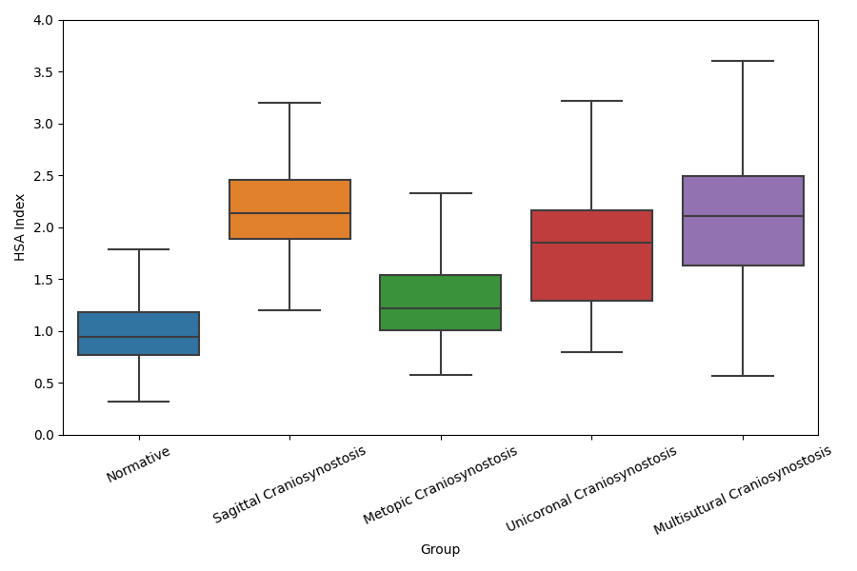
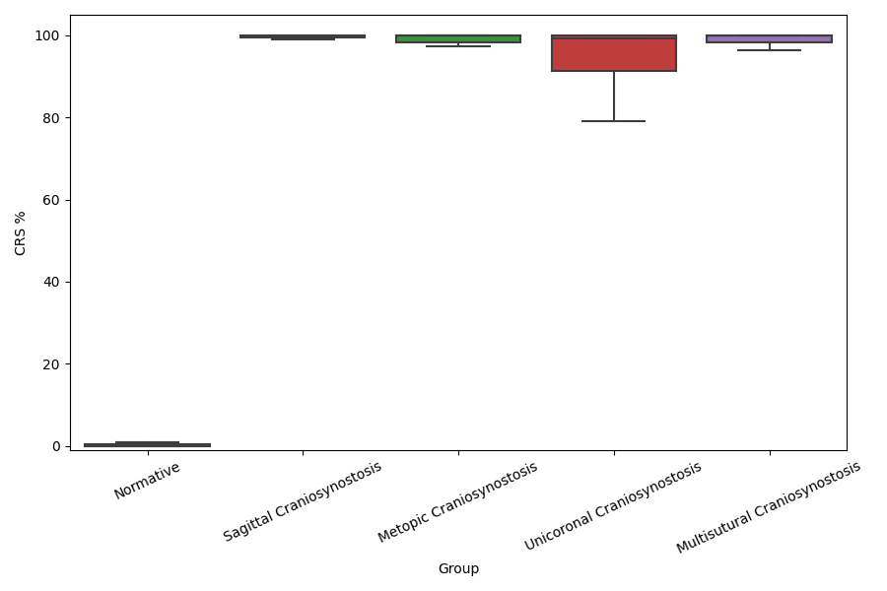
Metric Results

